Slide 1
Data science salary analysis

Slide 2
Overview
The data has 565 records and 11 fields and has been sourced from Kaggle.
This project is done for educational purposes only.

Slide 3
Objective
This project is done to observe and gain insights of the ever evolving field of data science salaries by their roles, experience levels and their job roles.
This project is also aimed to have a brief understanding on number of remote working in different companies and their salaries.
Identify trends for change in data science field salaries over time.
Analyse and get insights on countries paying highest salary for different experience levels.

Slide 4
Methodology
Data pre-processing is done using python, data manipulation and insights are generated using Tableau.

Slide 5
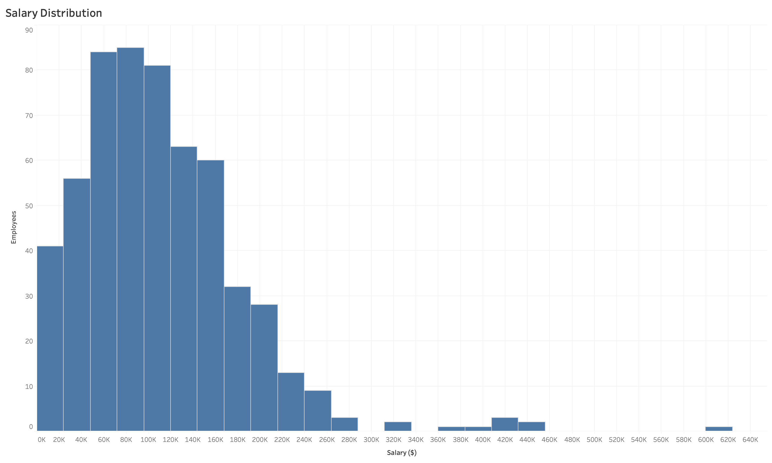
Results
Histogram representing distribution of salary for employees. Y – axis represents the Number of employees, X – axis represents Salary in Dollars. Majority employees were paid between 24k – 160k while a very small number of employees were paid between 320k – 440k.

Slide 6
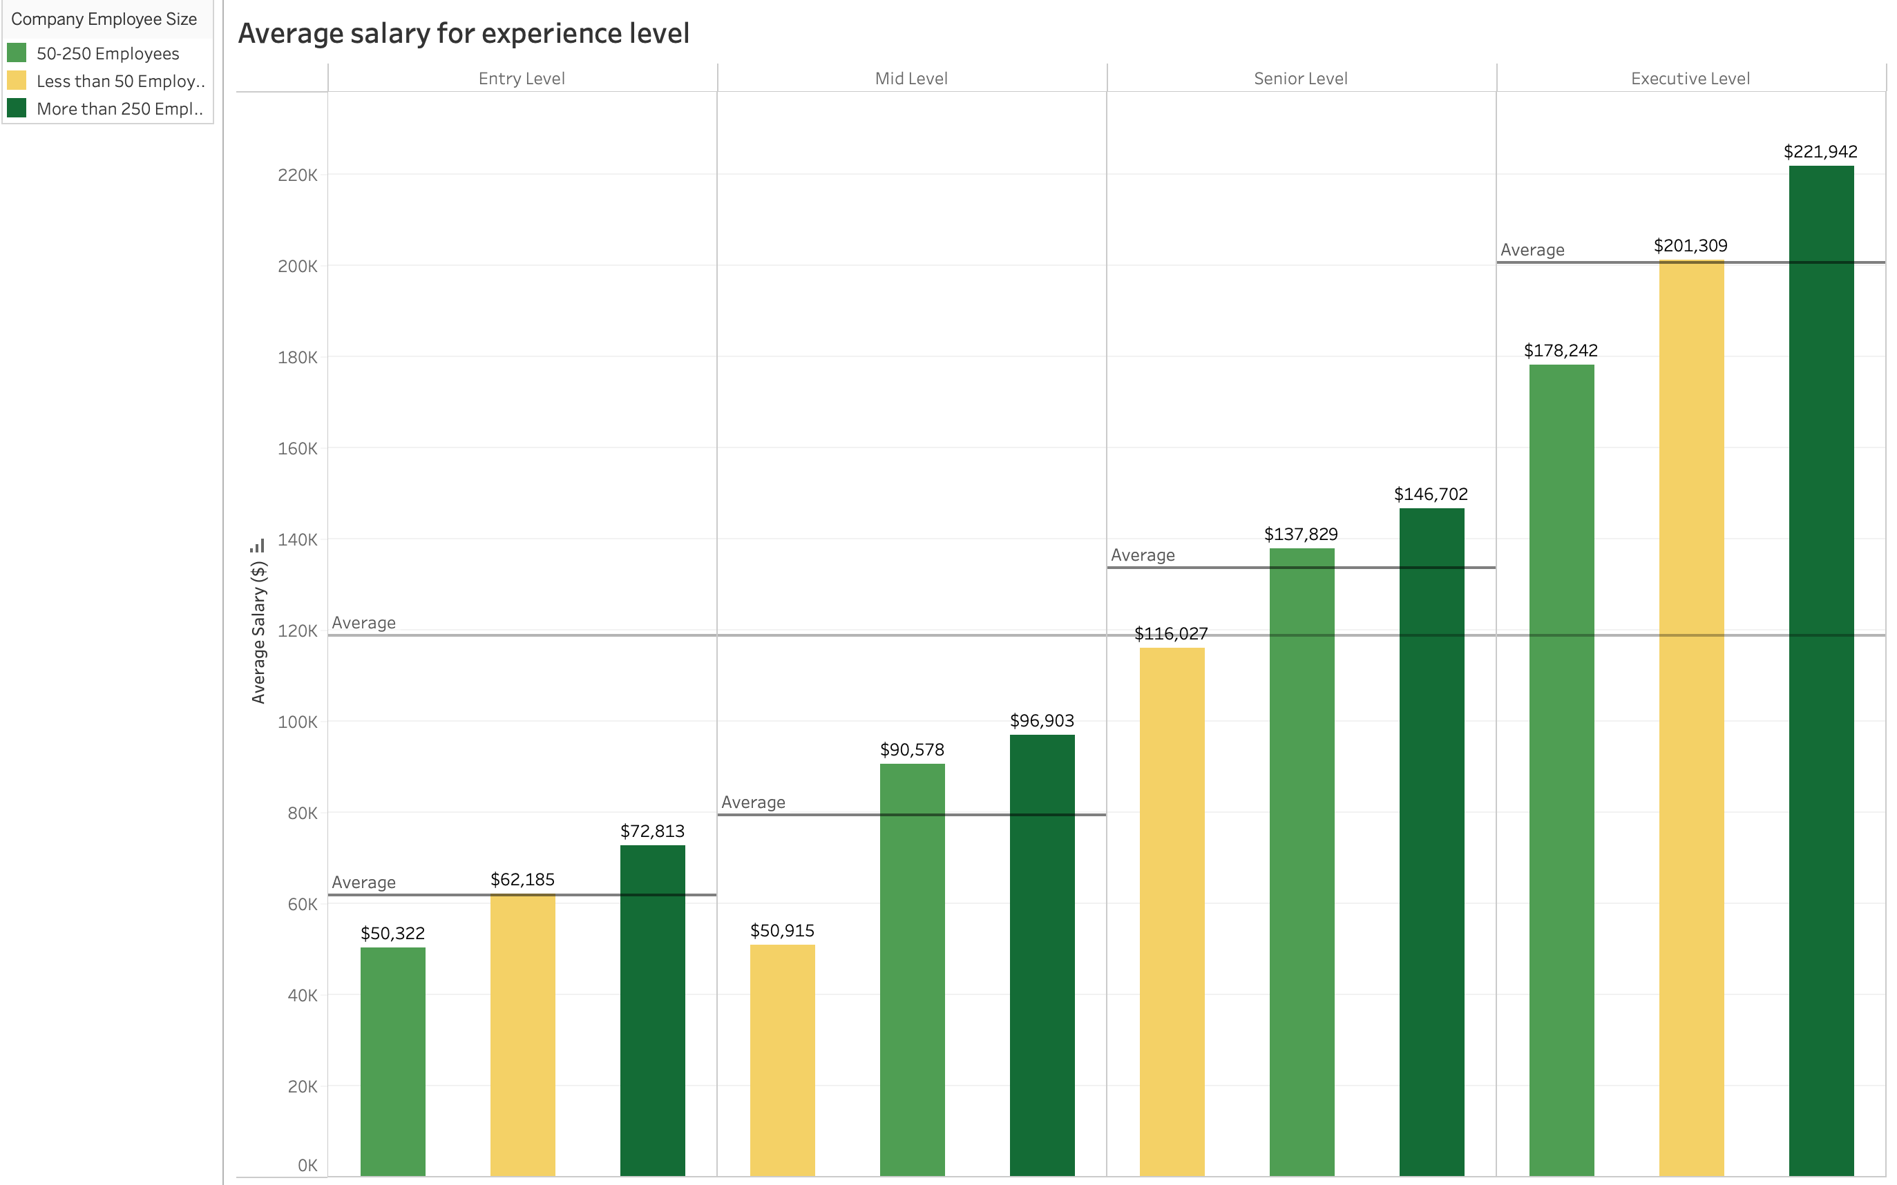
Bar chart portraying Average salaries for experience levels over different company size. Y – axis represents Average salary in Dollars, X – axis represents various experience levels and Legend represents different size companies.
Entry and Executive level : Employees were paid equal to or more than average salary only by large and small companies .
Mid and Senior level : Employees were paid equal to or more than average salary only by large and medium companies.

Slide 7
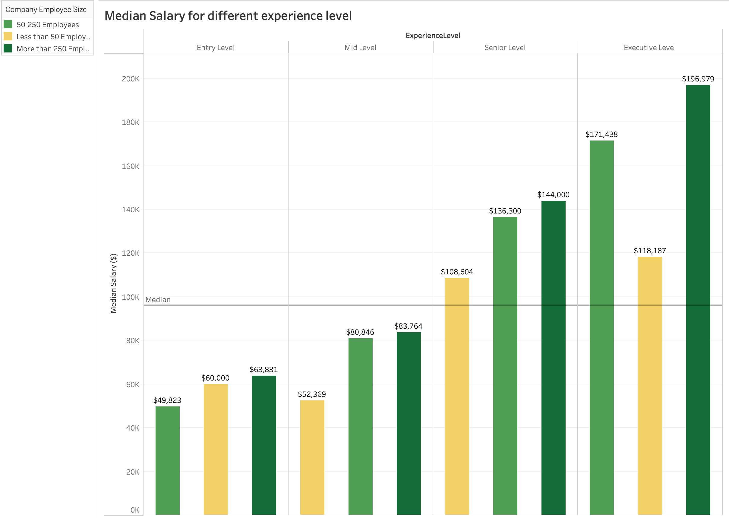
Bar chart portraying Median salaries for experience level over different size companies. Y – axis represents Median salary in Dollars, X – axis represents experience level over different company employee size.
Executive and Senior level : Employees were paid more than overall median salary. However, large and medium companies paid the highest.
Mid level : Employees were paid less than overall median salary. However, large and medium companies paid the highest.
Entry level : Employees were paid less than overall median salary. However, large and small companies paid the highest.

Slide 8
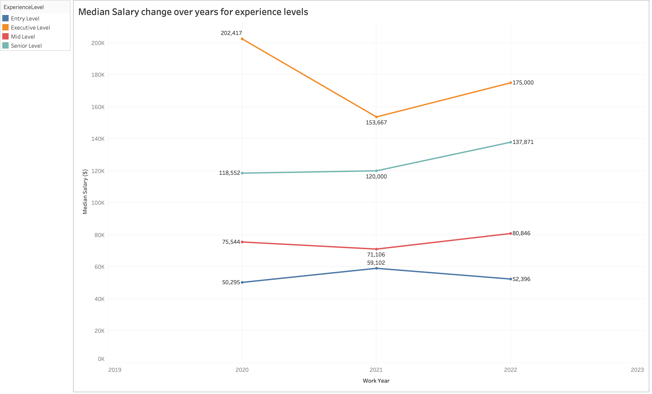
Line chart depicting Median salary change over year for experience levels. Y – axis represents Median salary in Dollars,
X – axis represents Year.
Executive level : Dramatic downfall in median salary over the years from 203k to 175k.
Senior level : Gradual increase in salary over the years from 119k to 138k.
Mid level : Slight increase in salary over the years from 76k to 81k.
Entry level : Negligible increase in salary from 50k to 52k over the years.

Slide 9
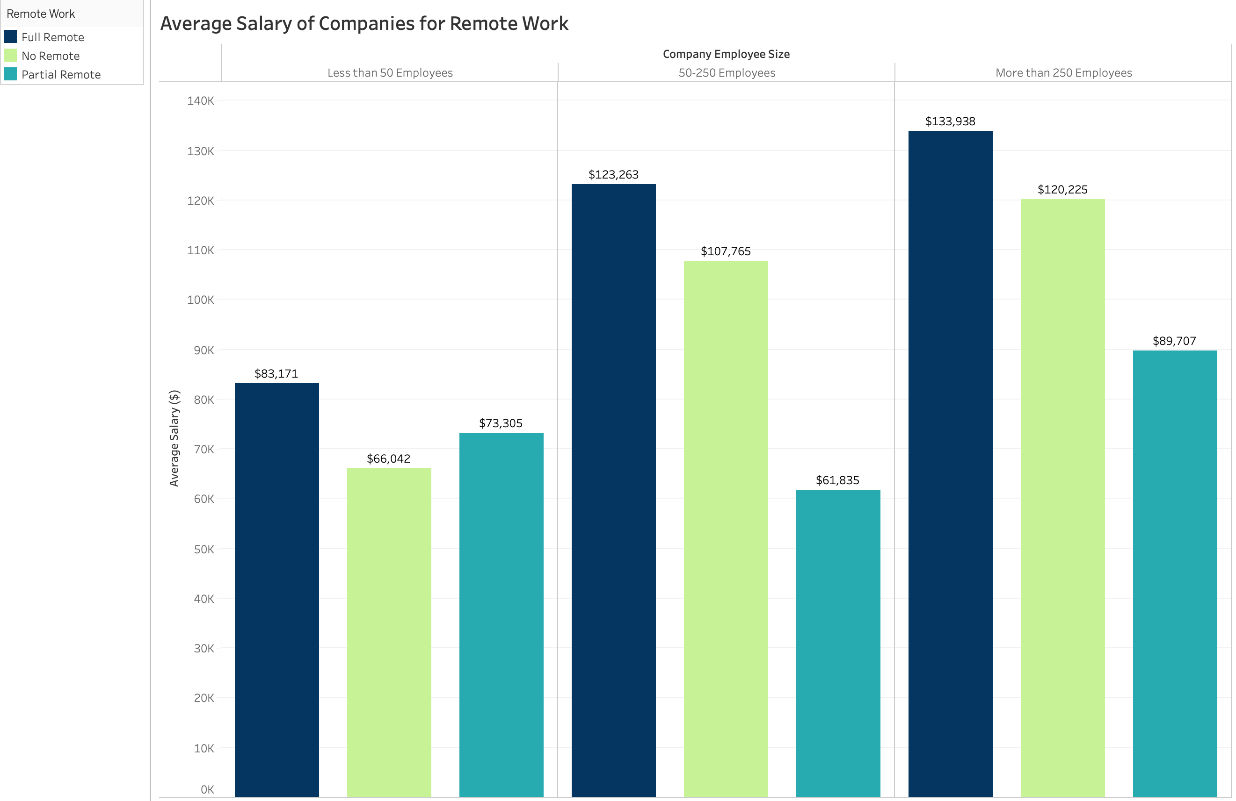
Bar chart depicts Average salary for remote work in different company employee size. Y - axis represents Average salary in dollars, X - axis represents Company employee size.
Small (less than 50 employees) company : Highest salary offered for full and partial remote roles.
Medium ( 50 – 200 employees) and Large ( more than 250 employees) company : Highest salaries offered for full and no remote roles. However, salaries vary according to their company sizes.

Slide 10
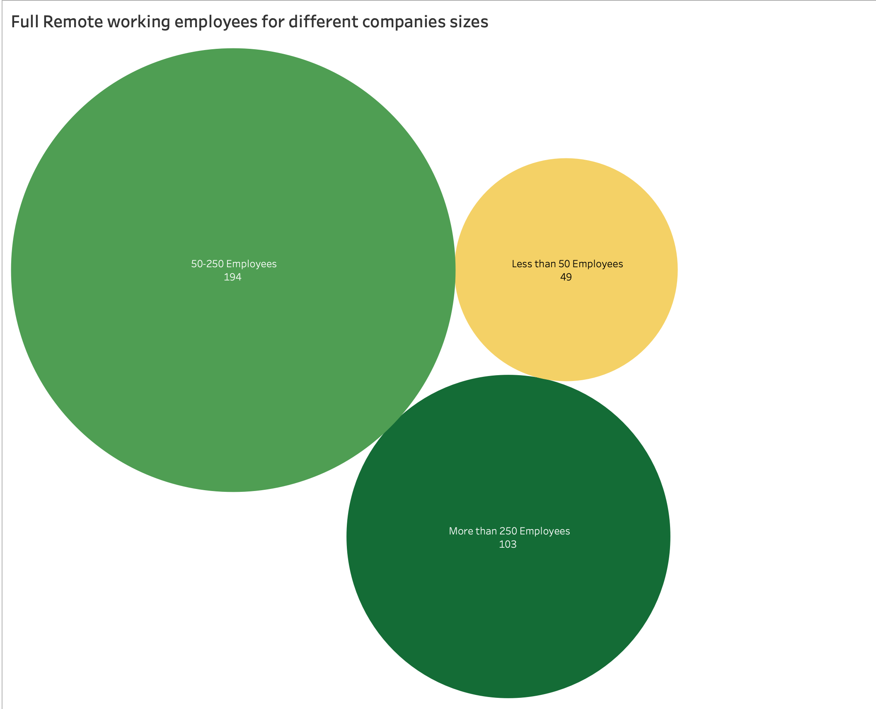
Packed bubble chart depicting Number of full remote working employees for different company sizes.
Small ( less than 50) and Medium (50 – 250 employees) companies had most of their employees working full time remote roles.

Slide 11
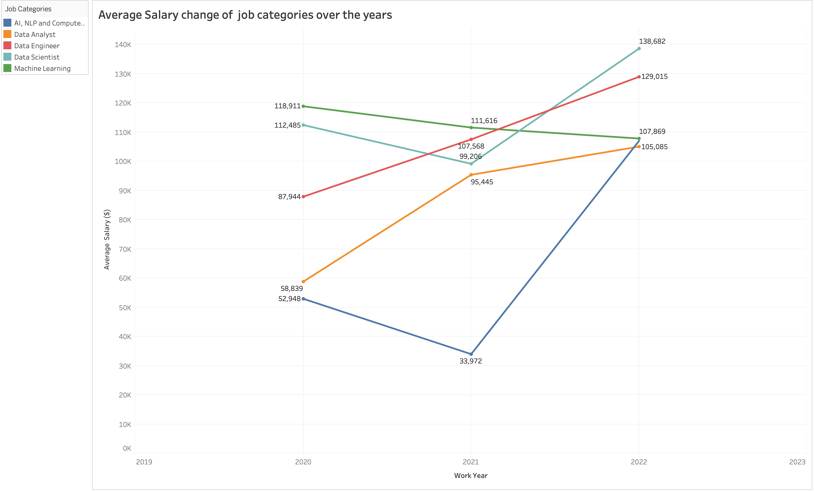
Line chart depicting Average salary change over year for job categories. Y – axis represents Average salary in Dollars,
X – axis represents Year with hue as job categories.
AI, NLP and Computer Vision : Dramatic spike in average salary over the years from 52k to 107k.
Data scientist : Gradual increase in salary over the years from 112kto 138k.
Data engineer : Average salary sky rockets from 88k to 130k over the years.
Data analyst : Twofold increase in salary from 58k to 106k over the years.
Machine learning : Slender decrease in salary over the years from 118k to 107k.

Slide 12
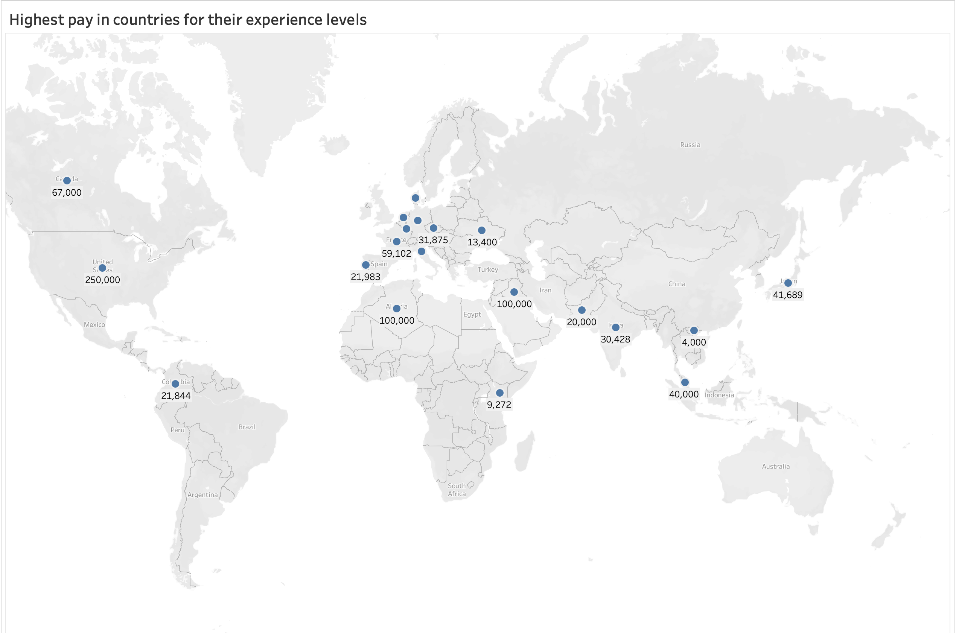
Global map representing Highest pay in countries for Entry level Data science roles.
The United states of America, Algeria and Iraq are the highest paying countries, whereas Vietnam, Kenya and Pakistan are the countries offering lowest pay.

Slide 13
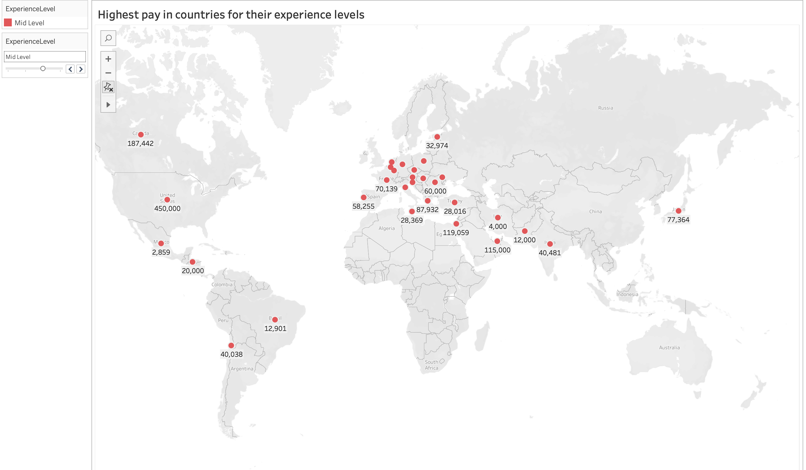
Highest pay in countries for Mid level Data science roles.
The United states of America (450,000), Canada (187,442) and Israel (119,059) are the highest paying countries.
Mexico (2,000), Iran (4,000) and Pakistan (12,000) are the lowest paying countries.

Slide 14
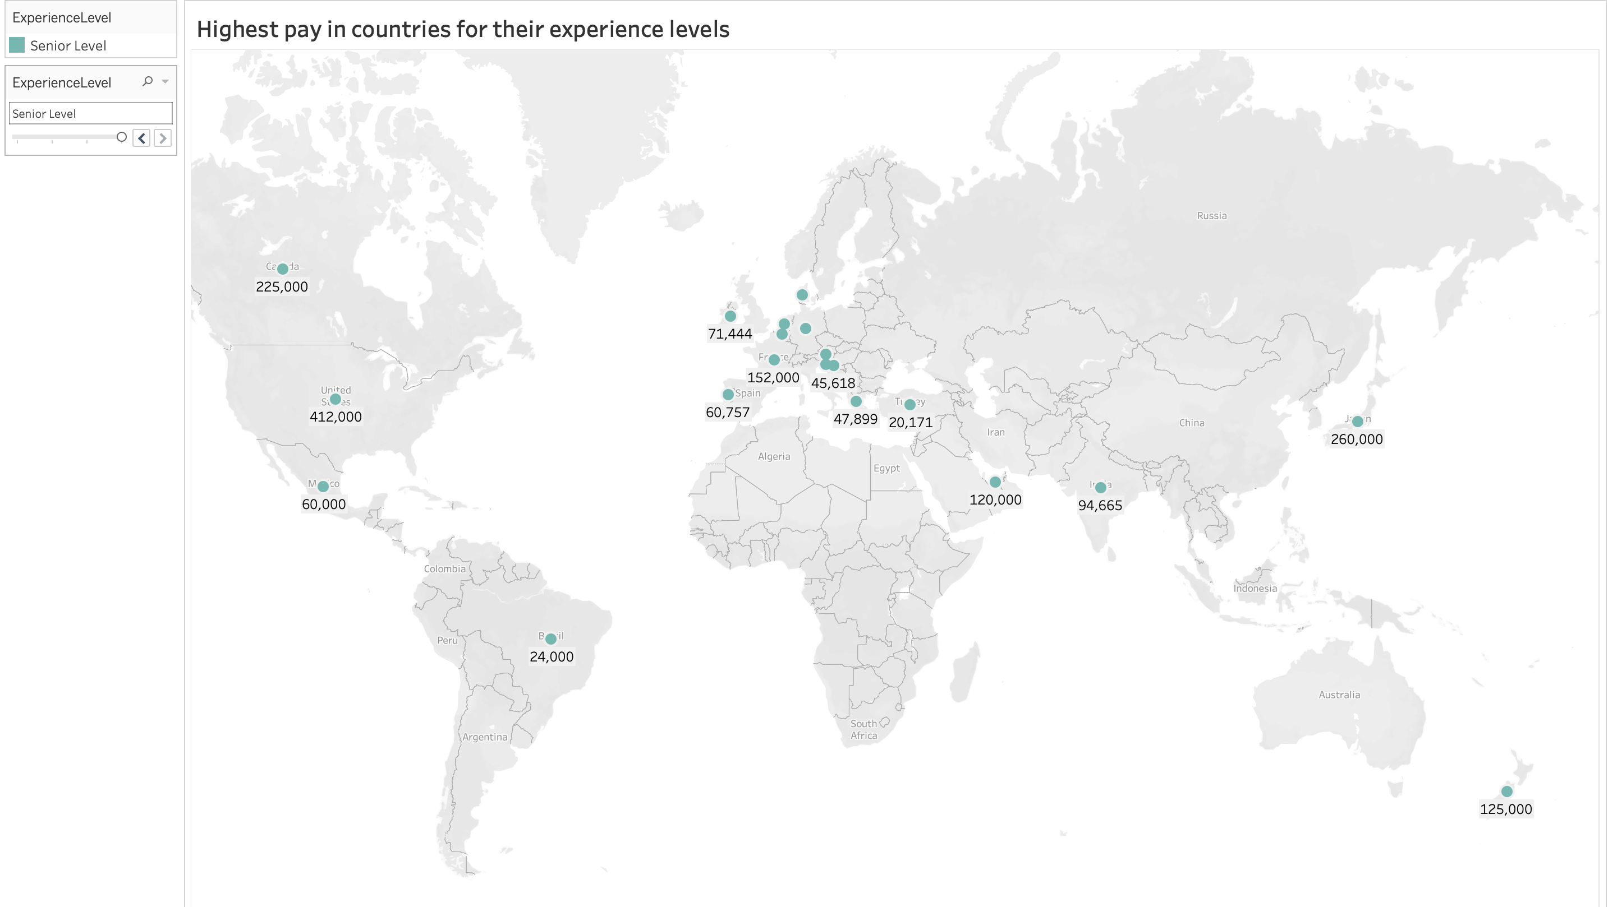
Highest pay in countries for Senior level Data science roles.
The United states of America (412k), Japan (260K) and Canada (225k) are the highest paying countries.
Brazil (24k), Greece (48k) and Mexico (60k) are the lowest paying countries.

Slide 15
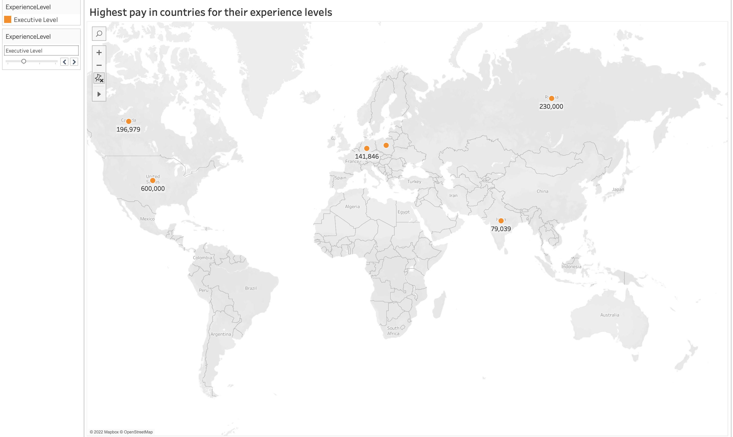
Highest pay in countries for Executive level Data science roles.
The United states of America (600k) is highest paying country, where as India (80k) is the lowest paying country.

Slide 16
Conclusion
Large and small companies pay higher salaries for all experience levels.
Remote working employees are high in small and medium companies and full remote working employees are paid the highest.
The United states of America is the only country which offers highest pay for their respective experience levels.

Slide 17
https://www.kaggle.com/datasets/ruchi798/data-science-job-salaries
Refer the above link for data and data dictionary.

